Slide 1

MENTORNESS Credit Card Prediction
Batch – MIP ML-14

Slide 2
Table of contents
01
02
03
04
05
06
Problem Statement
Introduction
EDA
Importance of modelling credit card approval
What we know so far
Getting to know our data
Feature Engineering
Model Deployment
Model Evaluation
To gain additional insights and model improvement
Experimentation to find the best performing model
Identifying most accurate model

Slide 3
Problem Statement
Current situation
01
02
03
Our primary task is to predict the approval or rejection of credit card application. The challenge lies in understanding the key factors influencing the target.
Raw Data
Outliers
Model Dev
Data needs to be processed to gain insights
Needs to be identified and treated accordingly
Choosing the best model for accurate prediction
Problems

Slide 4
Introduction
Faster Processing
Analyze applications swiftly, leading to quicker approvals
Wider Data Net
Utilize a broader range of data points beyond just credit scores
Objectivity
ML models make decisions based on data patterns minimising Human bias and inconsistency.

Slide 5
Exploratory Data Analysis
1.
Less than thousand missing values present in a dataset containing over 29k rows. That’s Data Quality of over 96%
2.
10+ categorical attributes present out of 19 attributes total
3.
Invalid entries found in 3 attributes

Slide 6
174,000
87,000
6 / 20
Data points present in numerical features.
Inconsistent values treated
Attributes encoded

Slide 7
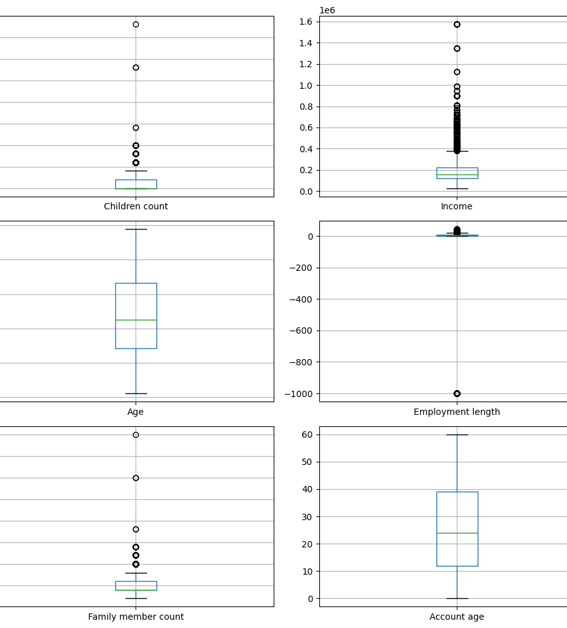
Feature Engineering
Outliers found in: Children count, Income, Employment length, Family member count
Children and family member count are redundant.
Employment length show negative filler values that needs to be dropped for accurate model prediction

Slide 8
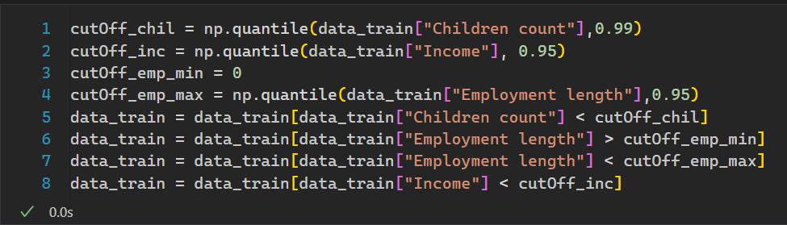

Slide 9
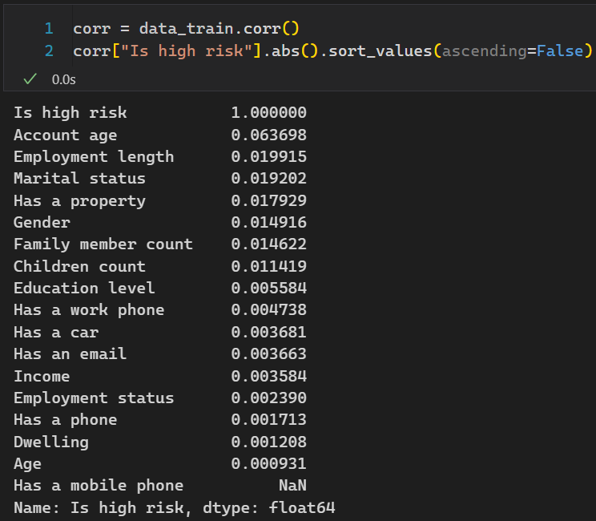
Correlation Analysis
At the heart of our desire, we want to achieve maximum absolute correlation with “Is high risk” attribute.

Slide 10
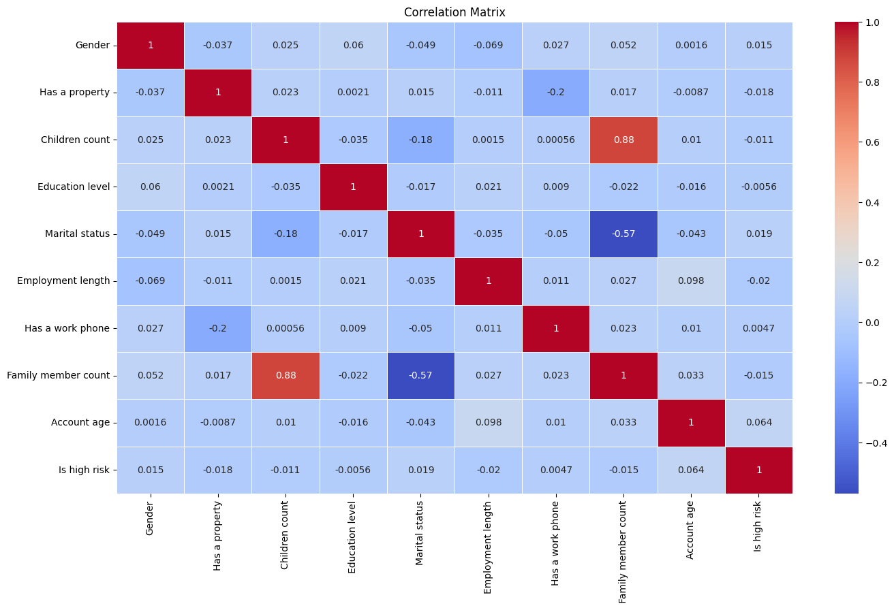
Correlation Plot

Slide 11
Model Deployment
Logistics Regression
Random Forest
A workhorse for classifying things as belonging to one of two groups
Wisdom of the crowds - combines multiple decision trees for more robust predictions.
Decision Tree
Gradient Boosting
A flowchart-like model asking a series of questions to arrive at a decision.
Teams up weak learners like decision trees for a powerful ensemble classification model.

Slide 12
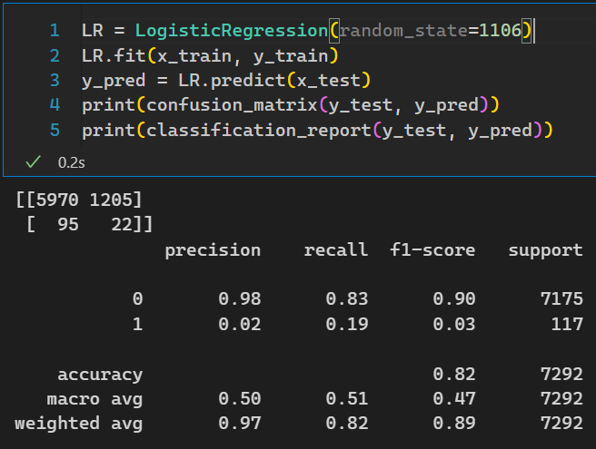
Logistic Regression

Slide 13
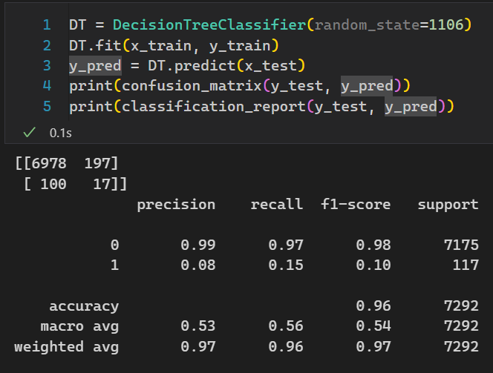
Decision Tree

Slide 14
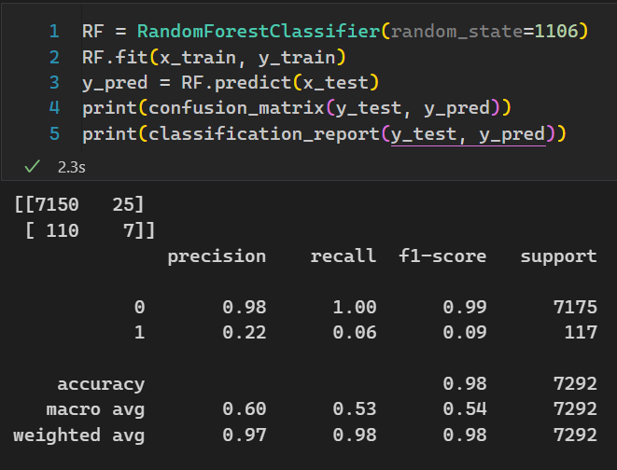
Random Forest

Slide 15
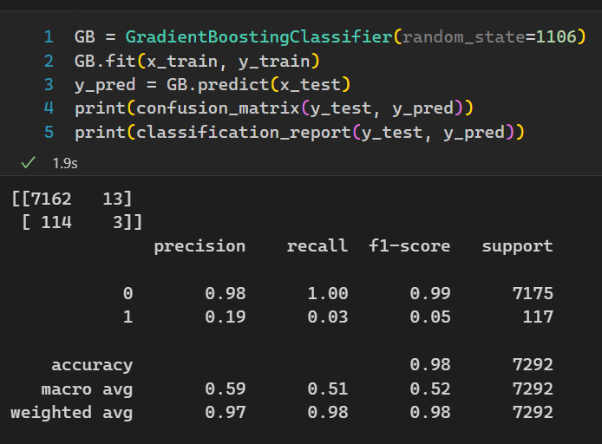
Gradient Boosting Classifier

Slide 16


Thanks!
Do you have any questions?
paarthmakkar99@gmail.com
www.linkedin.com/in/paarthmakkar

